Slide 1
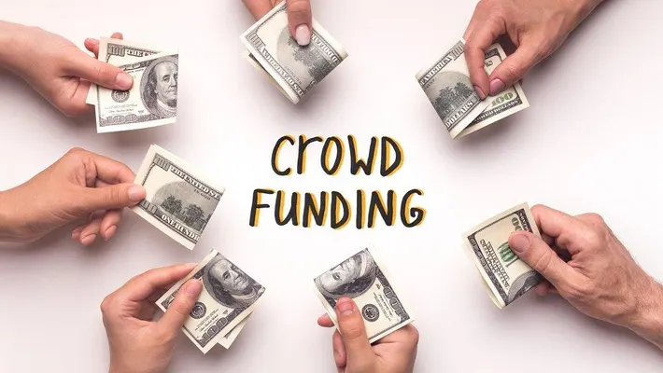

CROWDFUNDING
GROUP 5
Vinayak Kalyanashetti
Bhargavi
Seema Banu
M suriya
Vishakha
Preethi

Slide 2
WHAT IS CROWDFUNDING ?
Crowdfunding is a method of raising small amounts of money from a large number of people.
It is usually done through online platforms.
Used for funding projects, startups, products, causes, or emergencies.
It connects creators or fundraisers directly with supporters or backers.
Often involves social sharing to reach a wider audience.

Slide 3
PROJECT OVERVIEW
Purpose:
Analyze the crowdfunding platform data to understand trends, success rates, and key performance indicators (KPIs).
Scope:
Analyze funding outcomes
Identify top-performing categories and locations
Evaluate project success metrics and trends over time

Slide 4
PROJECT OBJECTIVES
To explore and visualize crowdfunding trends across different categories and locations.
To evaluate project performance based on outcomes (successful, failed, suspended, etc.).
To identify top successful projects based on:
Number of backers
Amount raised
To compute:
Percentage of successful projects overall and by various attributes
Average number of days for successful funding
To create a flexible, filter-enabled dashboard using interactive slicers (Year, Quarter, State).

Slide 5
METHODOLOGY
Data Preparation
Built a Calendar Table with key date attributes (Year, Month, Quarter, Weekday, Financial Month/Quarter).
Converted Epoch time to natural date format using reference tool.
Normalized goal amounts to USD using a static exchange rate.
Data Modeling
Integrated and cleaned multiple Excel data sources.
Created relational data model linking Projects, Dates, and Metrics tables.

Slide 6
KPI Calculations
Aggregated key metrics:
Total projects by category, location, outcome
Successful projects: amount raised, number of backers, average funding days
Dashboard Design
Built interactive visuals using pie charts, bar charts, and line graphs.
Used filters and slicers (Year, Quarter, State) for dynamic exploration.

Slide 7
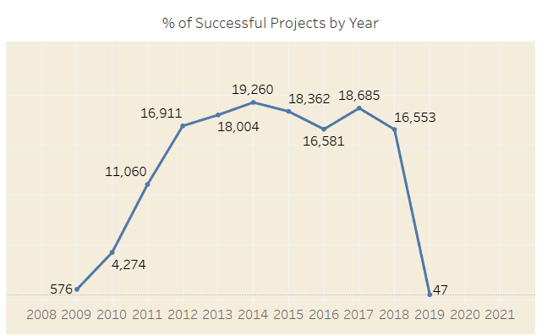
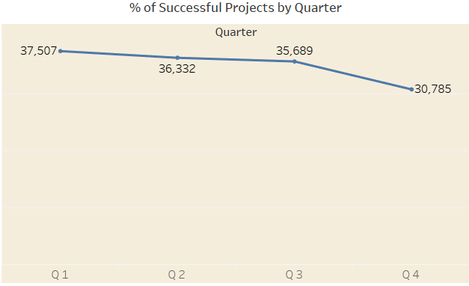
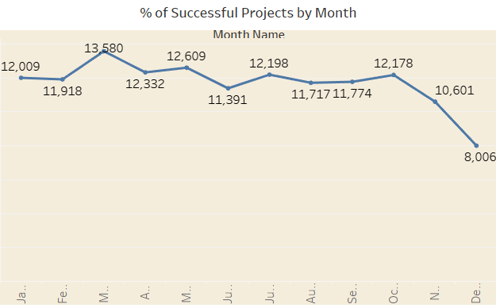
Success Rate Trends by Year, Quarter & Month
Yearly Trend
Success peaked during 2013–2015 with over 18K projects/year, followed by a sharp decline post-2018.
Quarter Trend
Q1 has the highest success, Q4 is the lowest, suggesting early-year launches perform better.
Monthly Trend
March and May show strong performance; December drops, likely due to holidays.

Slide 8
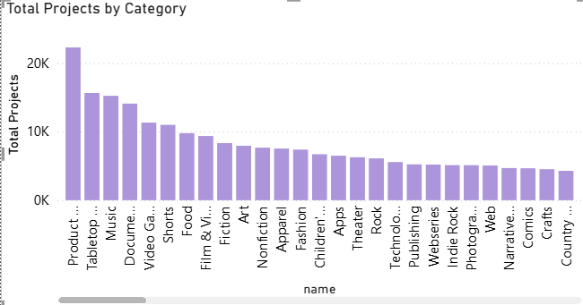
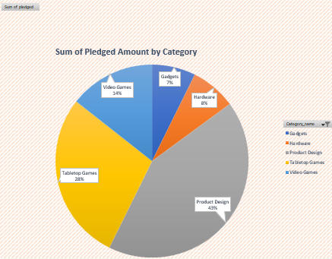
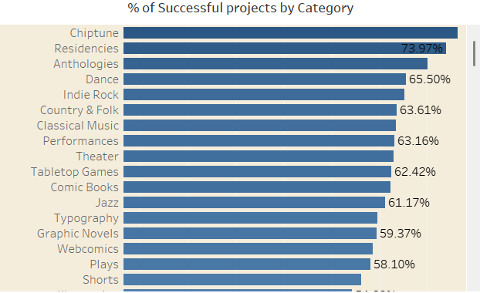
Category-wise Performance: Volume, Success & Funding
Total projects by category
Product Design has the highest number of projects, followed by Tabletop Games and Music. This shows which categories are most popular among creators.
Sum of Pledged Amount by Category
Product Design dominates funding, receiving nearly half of all pledged money. Tabletop and Video Games also attract significant financial support.
% of Successful Projects by Category
Smaller categories like Chiptune and Residencies have the highest success rates. This suggests that niche areas often perform better despite fewer projects

Slide 9
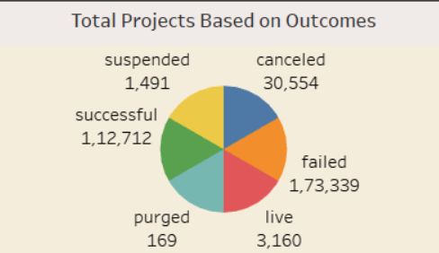
Crowdfunding Project Outcomes
A total of over 3 lakh projects were launched.
Only 37% of projects were successful.
The failure rate is the highest, with 1.73 lakh projects failing to meet their funding goals.
30K+ projects were canceled before completion showing challenges in campaign sustainability.
A small number are still live or suspended, and very few were purged.

Slide 10
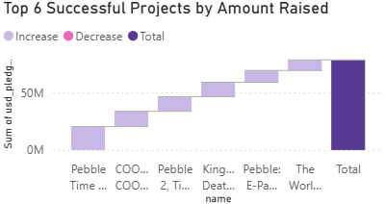
Top 6 Successful Projects by Amount Raised
This chart shows the top 6 most funded successful projects. Pebble Time and COOLEST Cooler raised the highest amounts, each contributing significantly to the total. These standout campaigns highlight how strong ideas can attract millions in backing

Slide 11
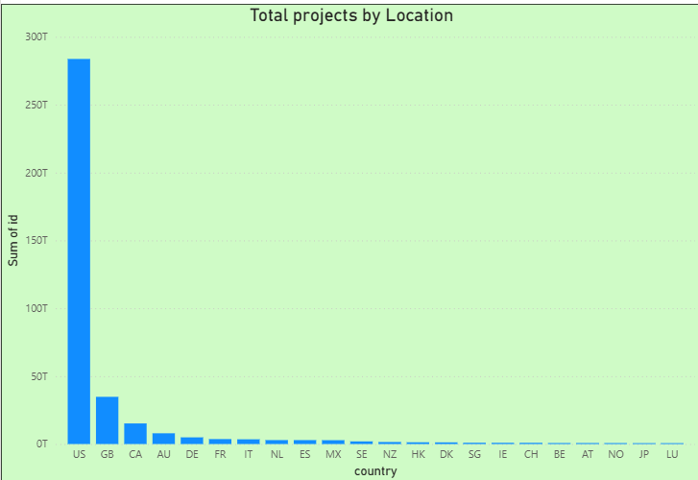
Geographic Distribution of Projects
This chart highlights the geographic spread of crowdfunding projects, showing that the United States overwhelmingly dominates with the highest number of projects. Other countries like the UK, Canada, and Australia contribute significantly, while the rest have a comparatively smaller presence.

Slide 12
Crowdfunding Dashboard: Strategic Insights
Based on visual analysis of multiple dashboards

Slide 13
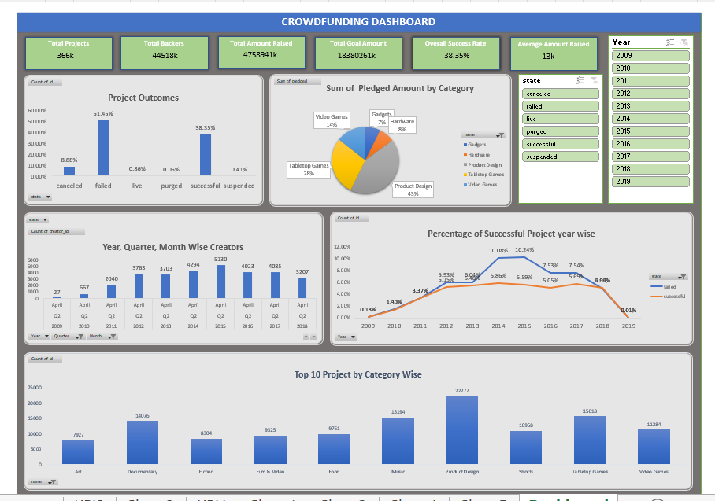
Excel Dashboard

Slide 14
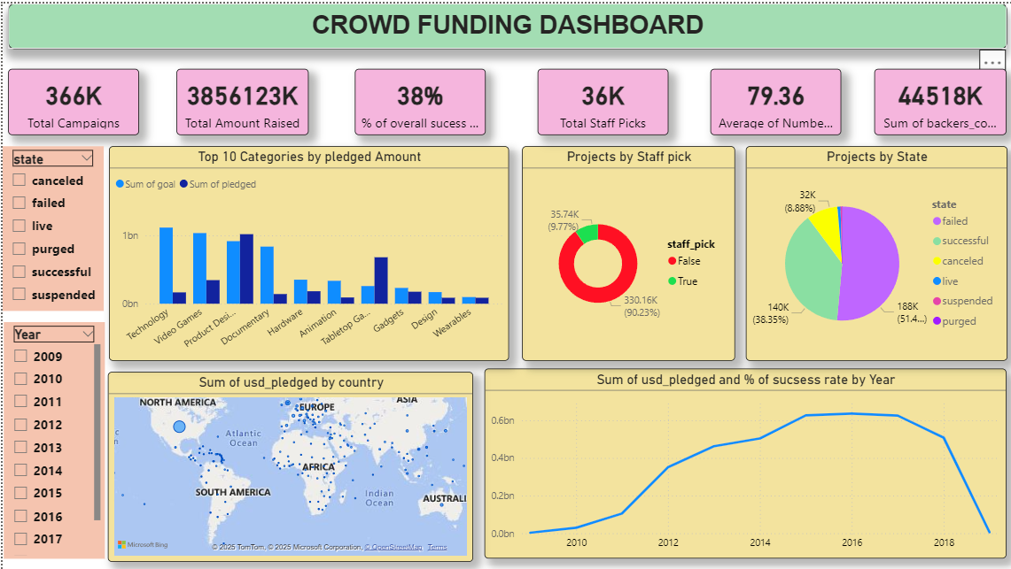
Power BI Dashboard

Slide 15
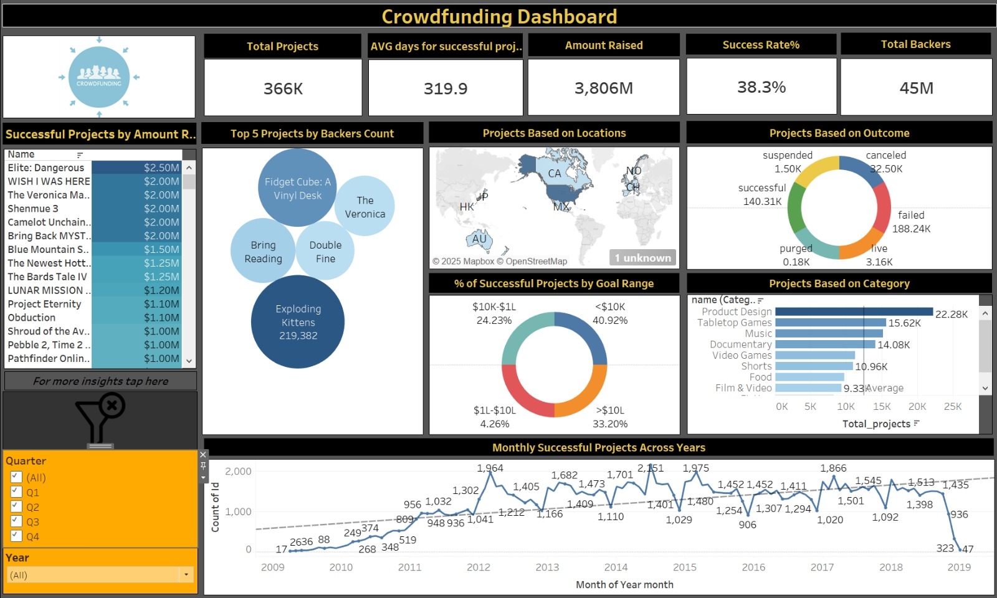
Tableau Dashboard

Slide 16
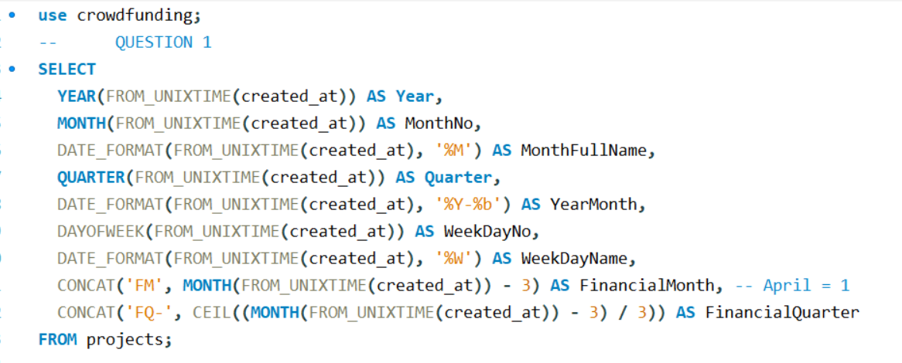
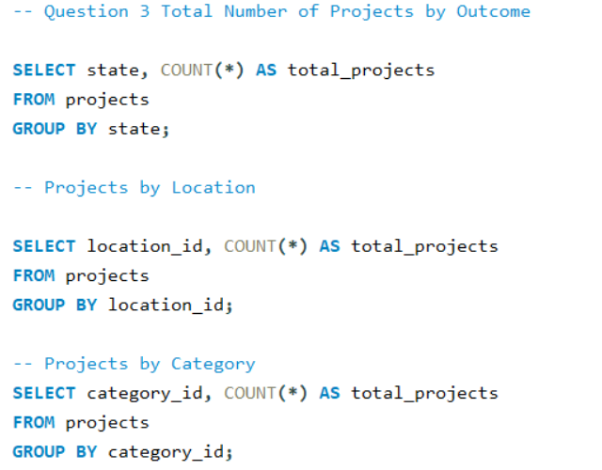
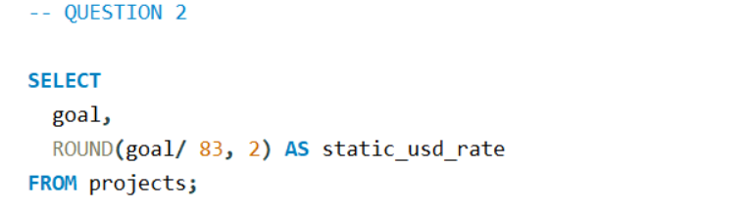
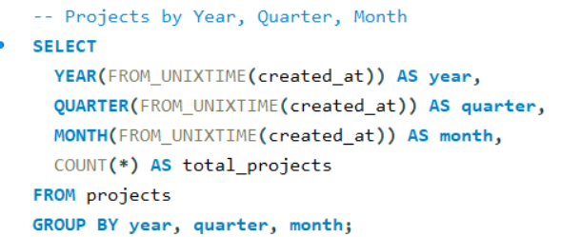
SQL Queries

Slide 17
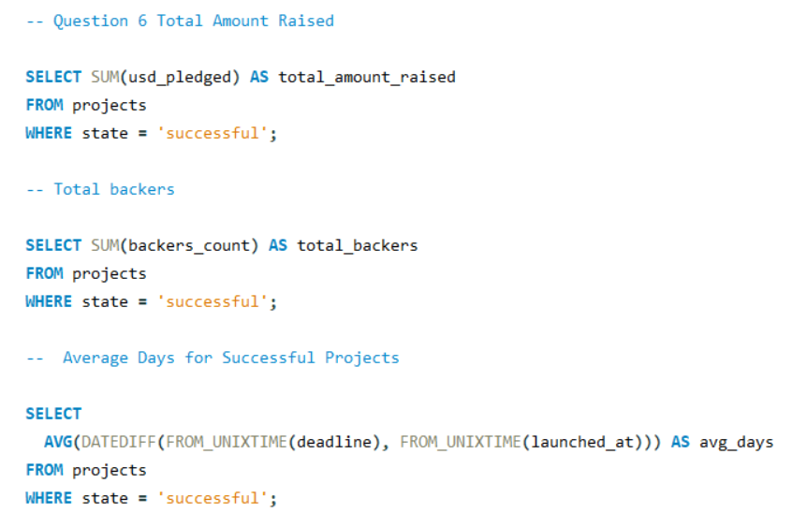
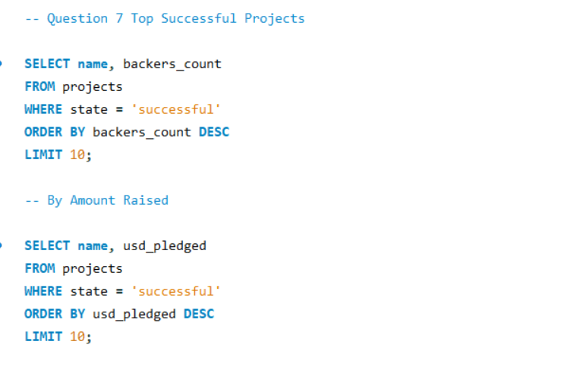

Slide 18
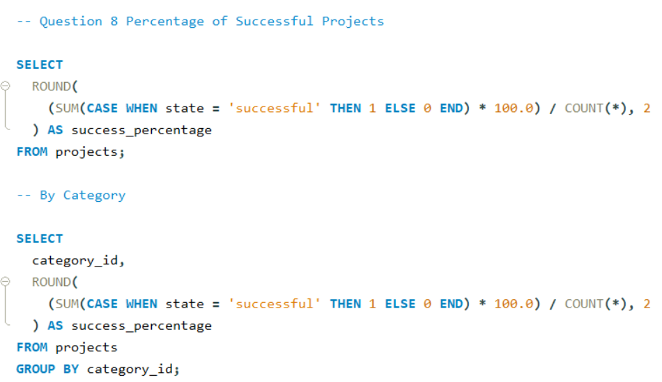
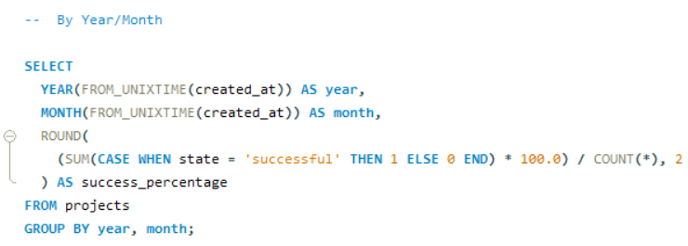

Slide 19
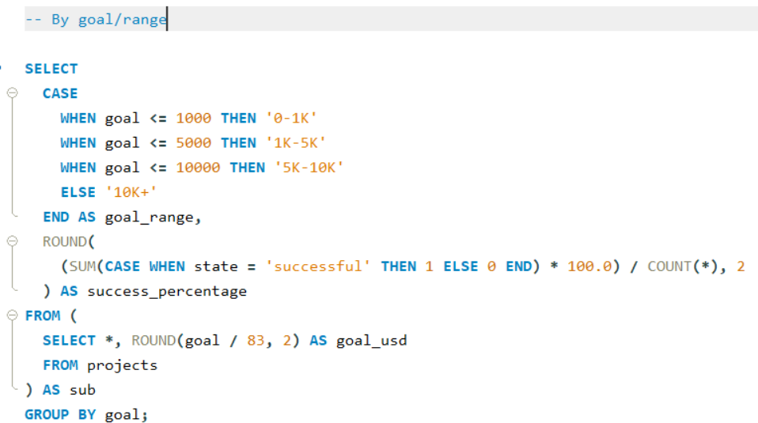

Slide 20
Campaign Overview
- Total Projects: ~366K
- Total Amount Raised: $3.85B – $4.75B
- Total Backers: ~45M
- Average Goal: $50K | Average Raised: $13K
- Success Rate: ~38.35% | Failure Rate: ~51%
👉 Crowdfunding is popular but most campaigns fail – careful planning is crucial.

Slide 21
Top Performing Categories
- Highest Funding: Product Design, Tabletop Games, Video Games, Music, Documentary
- Insight: Creative & entertainment categories dominate
👉 Focus on high-potential categories for better outcomes.

Slide 22
Geographic Insights
- Major Backers: USA, UK, Canada
- Low participation: Africa, South America, parts of Asia
👉 Platforms should expand to emerging regions with localization efforts.

Slide 23
Trends Over Time
- Growth peaked between 2014–2016
- Decline post-2017 in both project count and funding
👉 Indicates platform maturity – innovation is needed to regain growth.

Slide 24
Project Characteristics
- Only ~10% are staff-picked
- Smaller goals (1K–10K) = higher success rates
👉 Use achievable goals and seek visibility support like staff picks.

Slide 25
Final Strategic Insights
- Focus on top categories (Product Design, Games)
- Launch during Q2/Q3 with smaller goals
- Expand platforms in underserved regions
- Innovate to combat post-2016 decline
- Boost visibility through staff picks and community engagement

Slide 26
Thank You

